Slide 1
Outputs
Inputs
Questions that correspond to the notes on the right. These may be questions for the creator or lecturer, or may be questions you expect to see on an exam.
Summary to enable you to find the information easily.
Observations. These may be narrative or tabular.
Calculations.
Graphs.
Take notes on this side from things you did not produce.
Include data tables not created by you.
Include graphs not created by you.
Notes taken from a lecture, reading, video, examples of quantitative reasoning, Socratic Seminar, tutorials, pre-lab and post-lab discussions, etc.

Slide 2
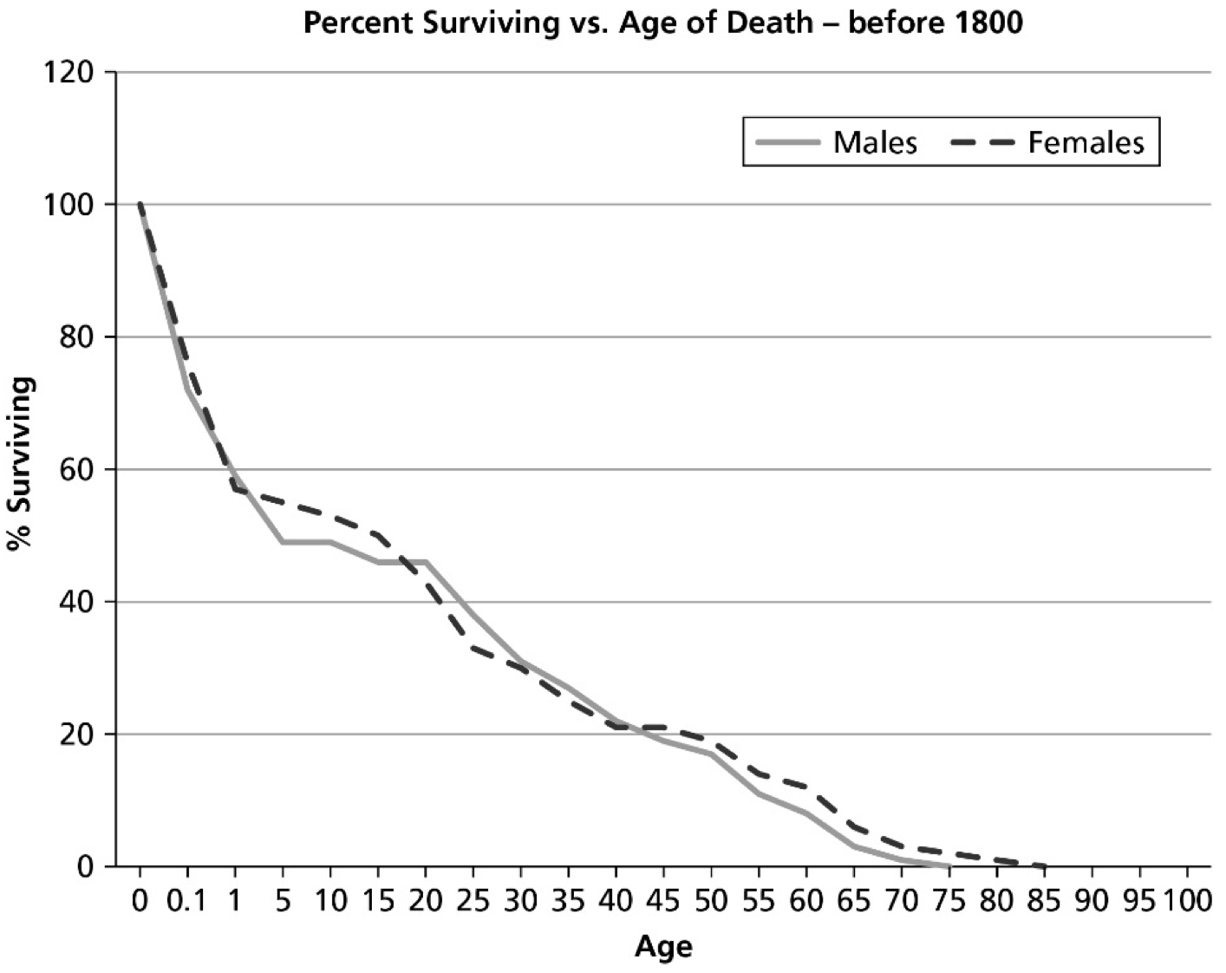
Human Survivorship Curves
Fieldwork at the Santa Maria Historic Cemetery
Results
Narrative Observations
Tabular Observation
Quantitative Reasoning
Graphs
Introduction
Background Information
Take notes on this side from things you did not produce.
Include data tables not created by you.
Include graphs not created by you.
Methods
If you are following the procedure from the lab manual, reference it here, then summarize.
“Human Survivorship Curves,” AP Teacher’s Resource Guide: Exploring Environmental Science for AP, prepared by Jeanne Kaidy, pp. 170 – 177 (Cengage 2019)
Summary
If you are following a different procedure, or conducting your own investigation, it needs to be detailed enough that anyone can follow it.
Discussion
Implications of your findings
Limitations of experimental design
Possible sources of error
Directions for future research
Questions that correspond to the notes on the right.
#summary

Slide 3
Human Survivorship Curves
Fieldwork at the Santa maria Historic Cemetery

Slide 4
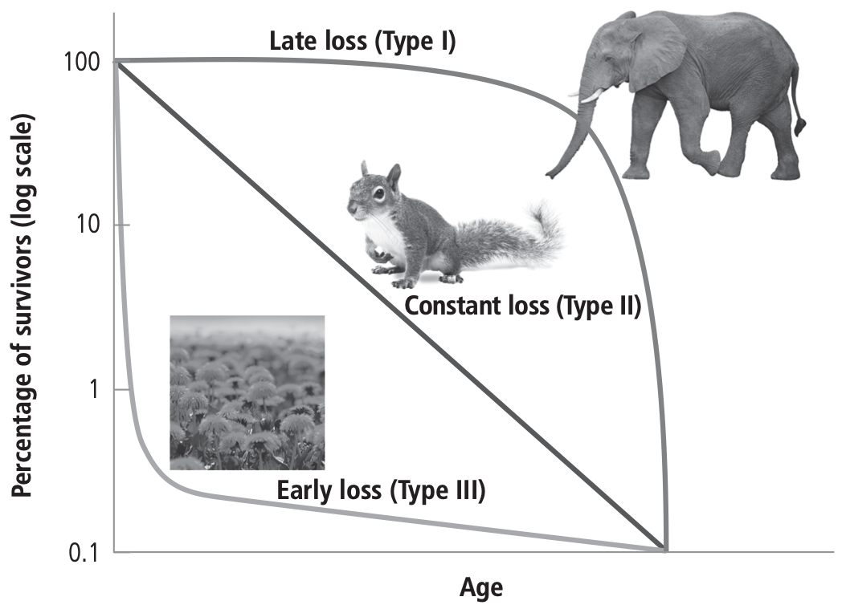
Background
As demographic transition progresses and living conditions improve, humans live longer.
Modern medicine, better quality food, technological advances, and other improvements have increased life expectancy.
A survivorship curve provides an illustration of life expectancy that can be correlated to environmental conditions. There are three types of survivorship curves:

Slide 5
A Type I curve exhibits late loss. This means that most individuals survive to old age before they die.
A Type II curve exhibits constant loss, meaning individuals have the same chance of dying at any age, usually from predation, disease, or poor nutrition.
A Type III curve exhibits early loss. This means that most offspring perish at a young age, usually where living conditions are very harsh and fertility and infant mortality rates are very high. A few individuals survive and live to old age, but life expectancy is low.

Slide 6
Trinity Church on Wall Street in New York City is one of the oldest cemeteries in the United States. This cemetery was an active burial ground from the 1660s to the 1820s. Burial data can be accessed at
http://registers.trinitywallstreet.org/files/history/churchyard/
The following data shows a sample of individuals buried in this cemetery that died before the year 1800.

Slide 7
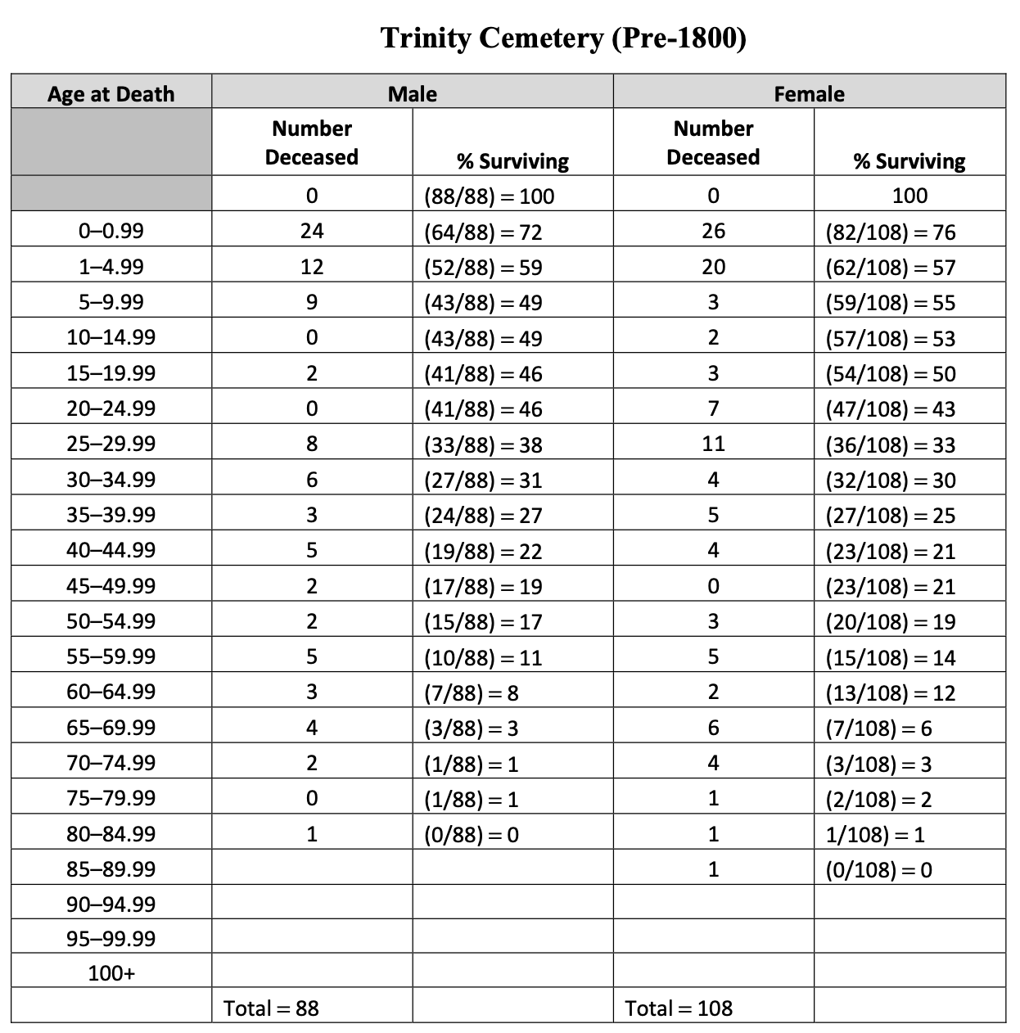

Slide 8
The individuals are categorized according to gender and the age at which they died. The data is recorded according to the age cohort, and the percent surviving for that population of males or females is calculated as follows:
Find the total number of males and the total number of females.
For the individuals that died at an age within the first cohort (0–0.99 year), subtract those individuals from the total population and use the remainder to determine what percent of the population remains. 88 total males − 24 males that died before age 1 64 members of the population remain 64/88 × 100 = 72% remaining
Twelve males between the ages of 1 and 4.99 years died in the next cohort. Subtract these individuals from the remaining population to determine the percent of the total population that remains. 64 males remaining − 12 males who died between the ages of 1 and 4.99 years = 52 remaining 52/88 × 100 = 59% of the population remaining
Continue to subtract away individuals from each cohort to determine the percent of the population that remains until the entire population has been subtracted away. Zero should be the last number in the percent remaining column.

Slide 9
Two lines are plotted on the graph, one for males and one for females. Plot the age (use the first number in the “Age at Death” column; for example, for the cohort 1–4.99 years, use “1”) on the x-axis and the percent surviving on the y-axis.

Slide 10
Procedure
Gather data for each of the data tables at a local cemetery or from obituaries or demographic records provided by your instructor.
Record the age of death according to age cohort and the gender of the individual.
Plot four lines on your graph using a different colored pencil for each line. You will plot four lines altogether, one for males and one for females who died before the year 1900, and one for males and one for females who died within the last decade.
Answer the questions that follow.
Male Age | Female Age
200 graves minimum!

Slide 11
Questions
Compare pre-1800 females (Trinity) to females from this century (Santa Maria.) What environmental conditions account for the difference in the curves?
Compare pre-1800 males (Trinity) to males of this century (Santa Maria.) What environmental conditions account for the difference in these curves?
What is the correlation between each of the graphs and the stages of demographic transition?
Which stage of demographic transition is represented by the Trinity Cemetery (pre-1800s) graph? Justify your answer.
Which stage of demographic transition is represented by the Santa Maria Cemetery (post-1900) graph? Justify your answer.
How might you expect the graph to change in the next century? Explain.

